Slide 1
CMPSC 100
Computational Expression

Slide 2

You’re already playing a game, but I’m not going to tell you the rules.
Compute it out, wizardfolk.

Slide 3
Now that you’re at the right table, discuss one question that you have about either reading, making sure to identify which you’re referring to.

Slide 4
Computational thinking
Idea advanced by Jeanette Wing (Carnegie Mellon) in the mid-2000s; has ancestors earlier (~1980)
Is made up of several ideas, but I settle on two:
Decomposition—breaking a problem apart
Abstraction—generalizing the “rules” governing a problem
How did you employ this kind of thinking to solve the game we played at the beginning of class?
How did you “decompose” it?
How/what did you “abstract?”
Fun fact: all of the table names are Ubuntu Unix builds.

Slide 5
Computational thinking
Stating the difficulty of a problem accounts for the underlying power of the machine—the computing device that will run the solution
JEANETTE WING, “COMPUTATIONAL THINKING”
“

Slide 6
Computational thinking: the Bit Ladder
0 0 0
_ _ _
_ _ _
_ _ _
_ _ _
_ _ _
_ _ _
1 0 0
Solve in 7 steps or fewer:
Transform the binary “word” “000” >> “100”
Changing only 1 bit at a time
You may only use a 1 or 0 in any position (no fancy “bases” other than 2)

Slide 7
Computational thinking: the Bit Ladder
0 0 0
0 0 1
0 1 1
0 1 0
1 1 0
1 1 1
1 0 1
1 0 0
Solve in 7 steps or fewer:
Transform the binary “word” “000” >> “100”
Changing only 1 bit at a time
You may only use a 1 or 0 in any position (no fancy “bases” other than 2)

Slide 8
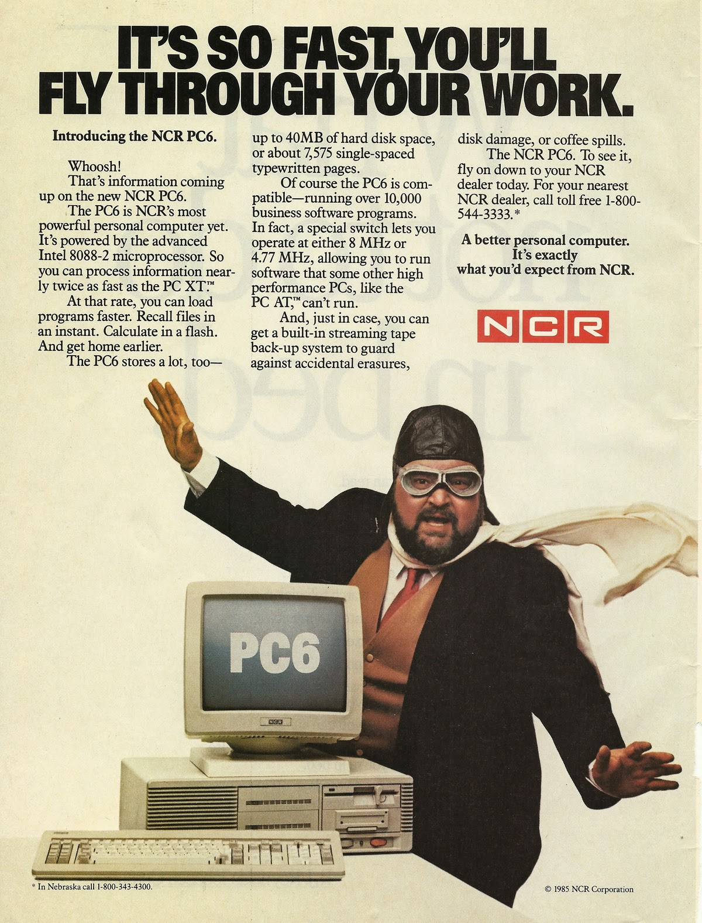
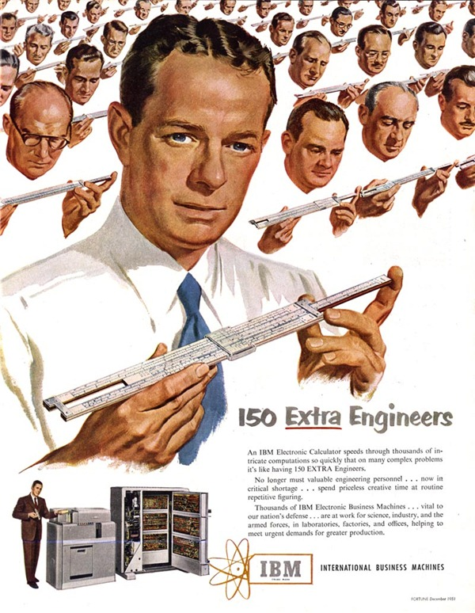

Slide 9
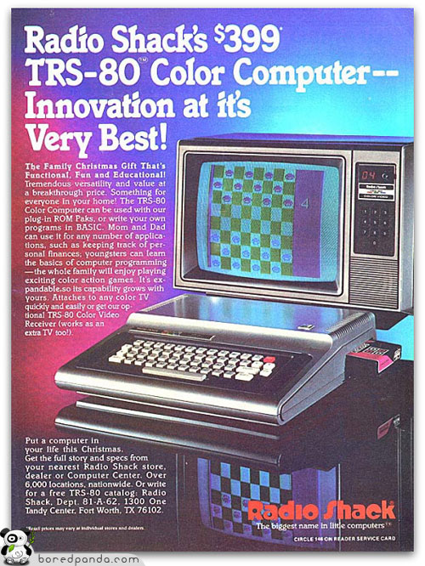
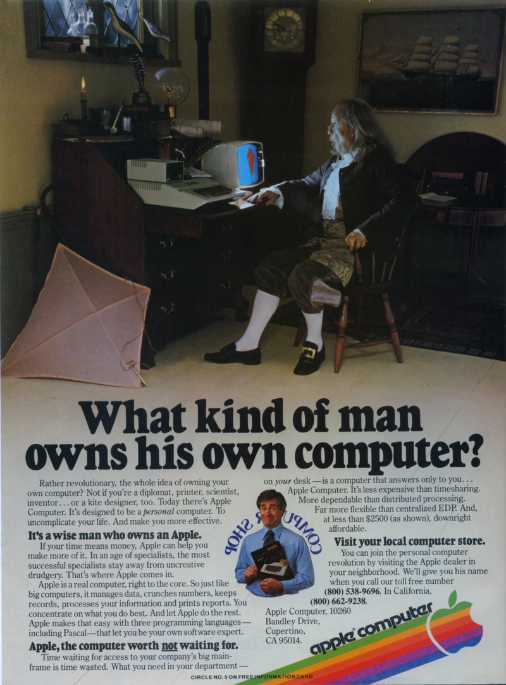

Slide 10
Current computers aren’t that different
The main computer hardware components are still:
CPU
Main Memory (RAM)
Secondary Memory (hard disk drive; solid state drive)
The main computer software components are still:
The operating system
Peripheral devices, though useful to us humans are, in most cases, for our convenience.

Slide 11
Current computers aren’t that different
Much like systems 60+ years ago, we still measure memory using:
Metric prefixes like kilo-,mega-,giga- (we’ve really only crept up the scale over time)
Base 2 (binary) number systems as basis for representing information
Digital vs. analog representation

Slide 12
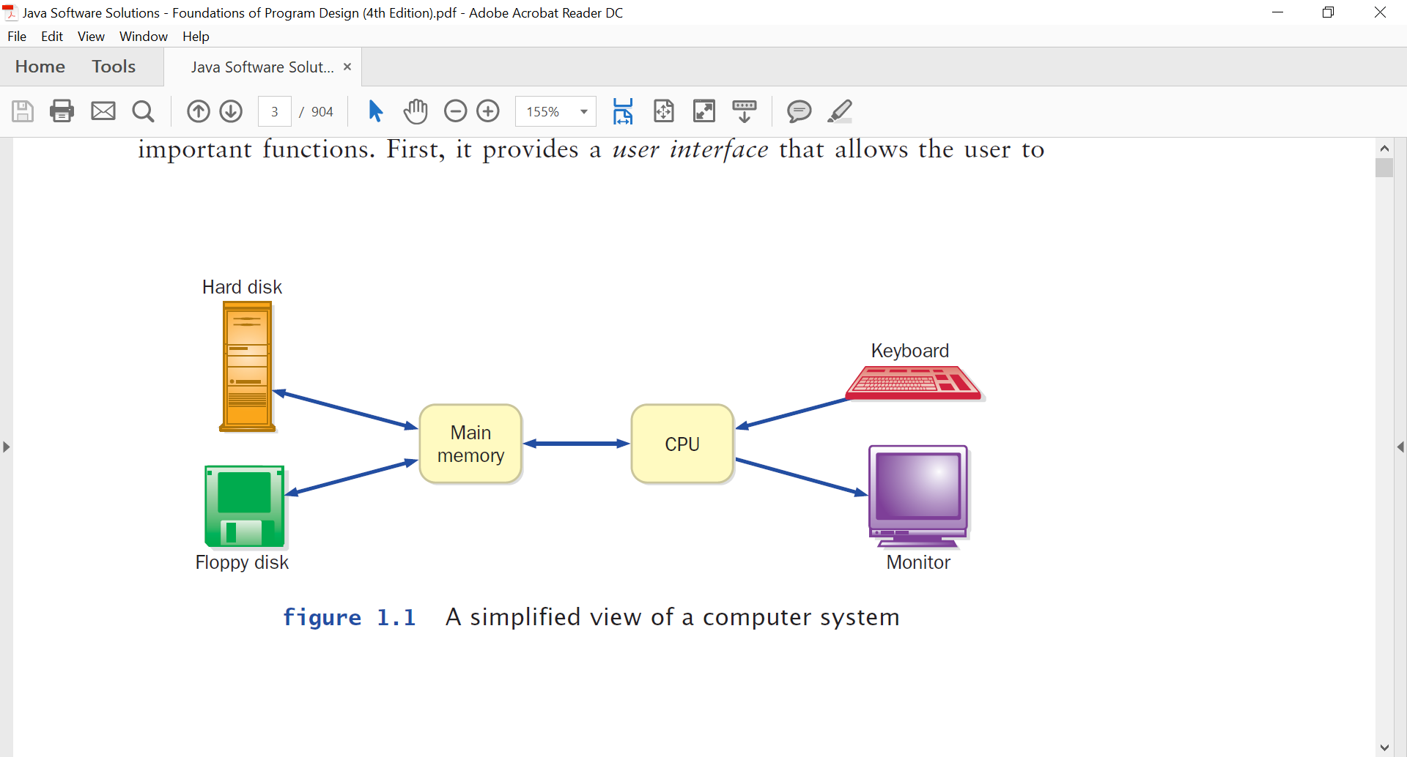
But what does this have to do with us?

Slide 13
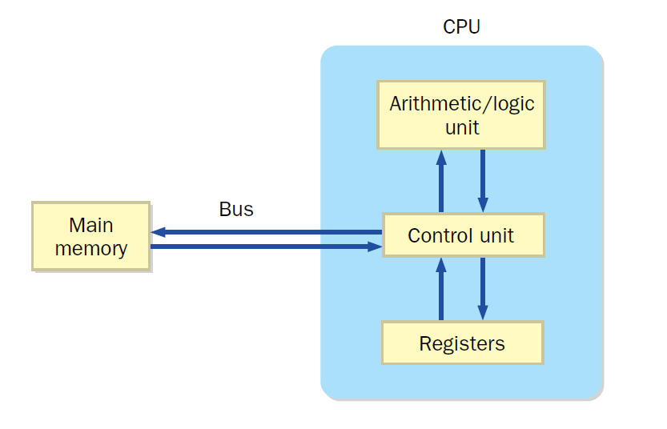
Current computers aren’t that different

Slide 14
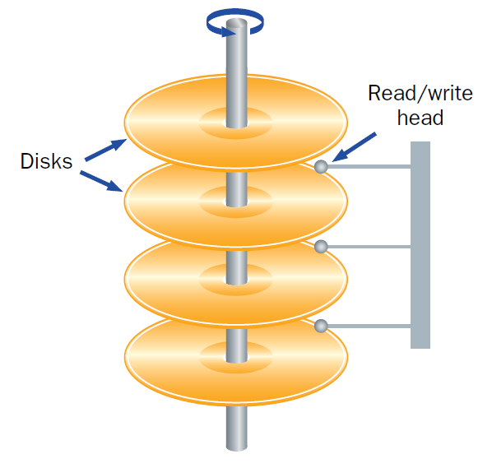
Current computers aren’t that different
01101100 01101100 01101100
01101100 01101100 01101100
01101100 01101100 01101100
01101100 01101100 01101100
01101100 01101100 01101100
01101100 01101100 01101100
01101100 01101100 01101100
01101100 01101100 01101100

Slide 15
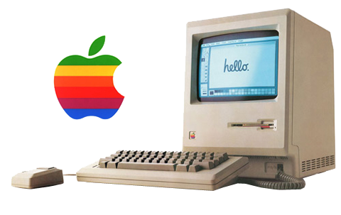
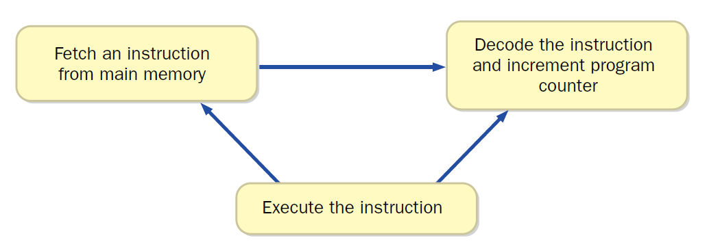
Current computers aren’t that different

Slide 16
But what does this have to do with us?

Slide 17

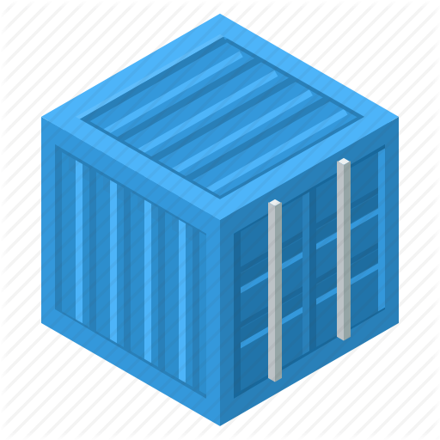
But what does this have to do with us?

Slide 18
So what is a “container?”
A container is a standard unit of software that packages up code and all its dependencies so the application run quickly and reliably from one computing environment to another.
DOCKER WEBSITE
“

Slide 19
So what is a “container” really?
In this course, take container to mean:
An operating system image:
built from a Dockerfile that is
based a “base” image stuffed with extra software so
when run (“containerized”) dumps into main memory &
ensures that everyone’s software runs the same way everywhere independent of personal system config.

Slide 20
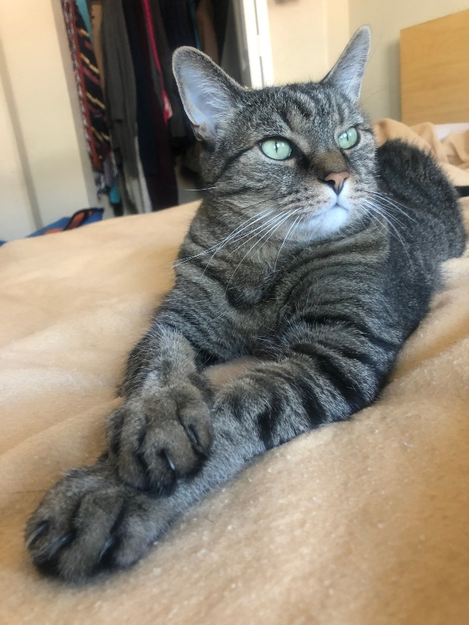
Tangent: what is an “image?”
Unfortunately not this.

Slide 21
Tangent: what is an “image?”
A snapshot of a computers “file systems” at a given point in time.
You can have:
A Unix image
A Windows image
A Mac image
We can even take snapshots of personal machines, and install them elsewhere!

Slide 22
So what is a “container” really?
Dockerfile > Image > Container
But, sometimes…
Base image > Dockerfile > Image > Container

Slide 23
I have 01100011 problems, “containers” are 01
“dumps into main memory”: Or, a Problem or Not?

